Slide 1
Replication

Slide 2
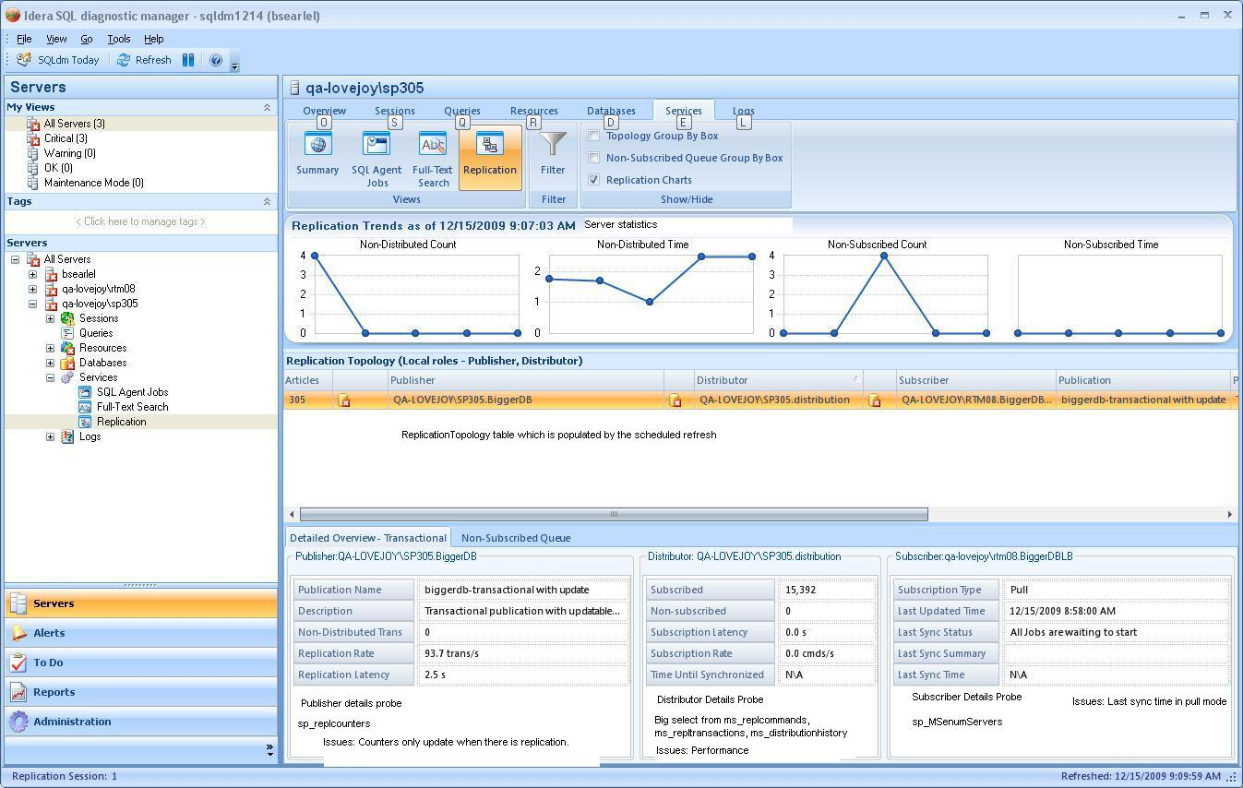

Slide 3
Probes
Scheduled Refresh
ReplicationCollector
Replicationcheck.sql
Replicationcheck2005.sql
Distributor Details
DistributorDetailsCollector
ReplicationDistributorDetails2000.sql
ReplicationDistributorDetails2005.sql
DistributorQueueCollector
DistributorQueue2000.sql
DistributorQueue2005.sql
Publisher Details
PublisherDetailsProbe
PublisherCountersCollector (sp_replCounters)
ReplicationStatusCollector
ReplicationsStatus.sql
AlternateDistributionStatusCollector (sp_get_distributor)
Subscriber Details
subscriberDetailsCollector (sp_Msenumsubscriptions)

Slide 4
ReplicationTopology
ArticalCount
PublisherInstance
PublisherDb
Publication
DistributorInstance
DistributorDb
SubscriberInstance
SubscriberDb
PublisherDBID
DistributorDBID
SubscriberDBID
ReplicationType
SubscriptionStatus
PublicationDescription
........Associated metrics

Slide 5
ReplicationTopology
The scheduled refresh determines which roles the monitored server is fulfilling and queries accordingly.
A replication object model is updated with the data.
The collections of publications, subscriptions and distributors are keyed off the names of the publications, databases and instances.
The topology table is updated from the returned replication object model.
The table has no key, but programmatically the key is the unique combination of the publisher instance, publisher db, distributor, distributor db, subscriber, subscriberdb and publication.
In future I would create a hash of these and use it as the primary key on the table.
If a session has not got a subscriber and then a subscriber is added, it becomes a new session. The old session is groomed and the new one is added. Any changes to the “key” results in this behavior.

